Slide 1
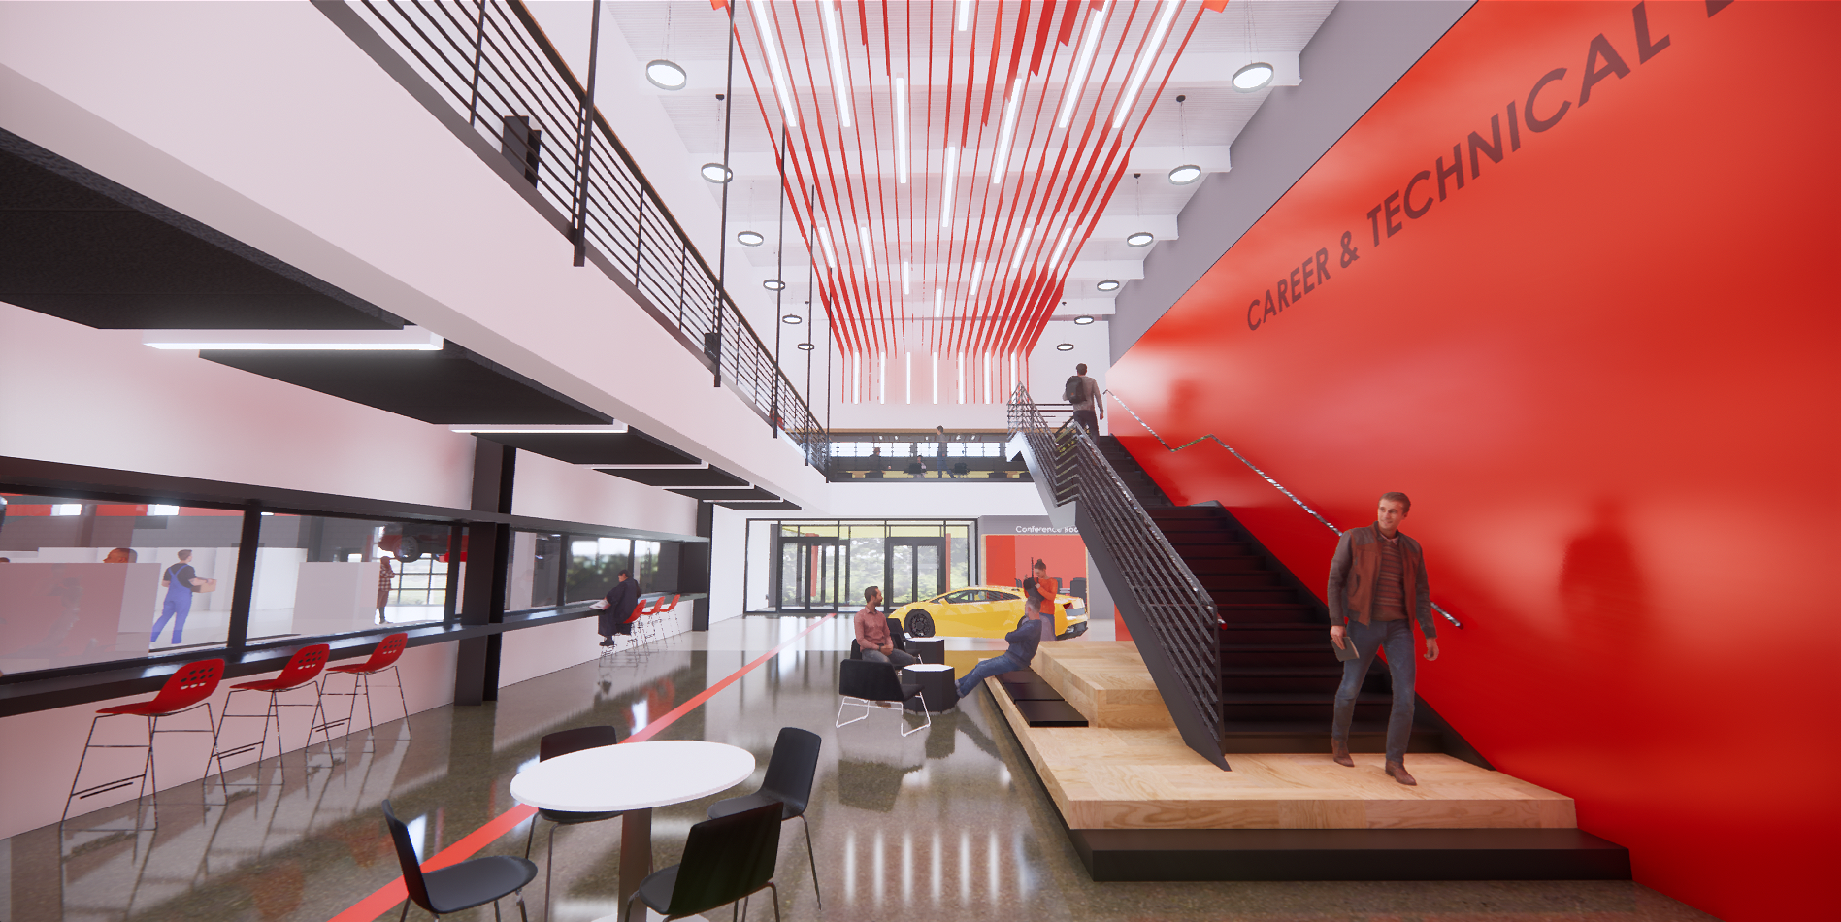
Waubonsee Community College
New TEC Facility – Board Update
October 16, 2024

Slide 2
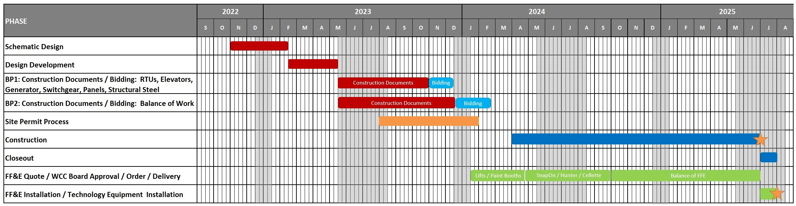
WAUBONSEE COMMUNITY COLLEGE
New TEC Facility
Project Timeline Update

Slide 3
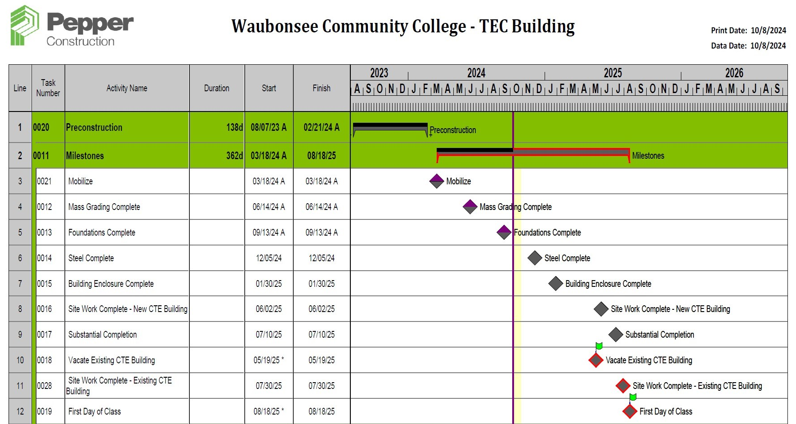
WAUBONSEE COMMUNITY COLLEGE
New TEC Facility
Construction Timeline

Slide 4
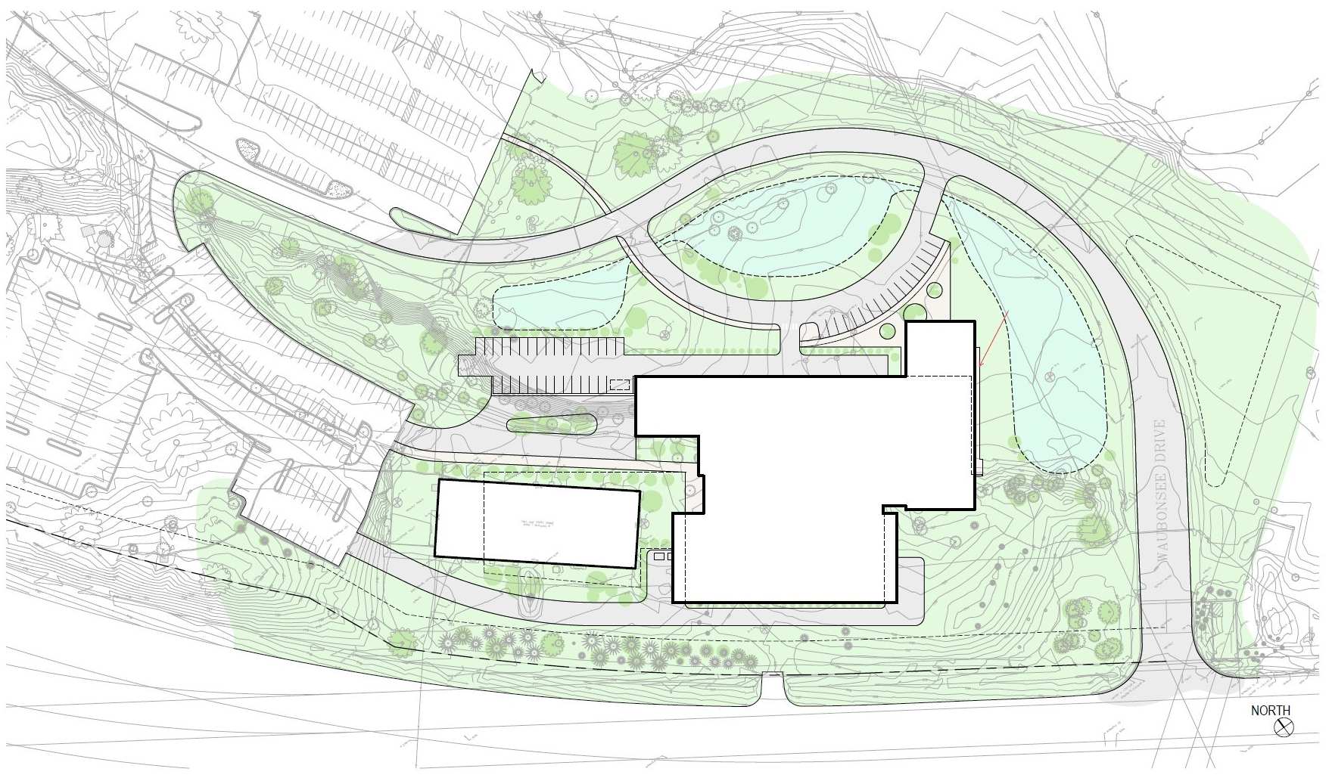
WAUBONSEE COMMUNITY COLLEGE
New TEC Facility
Site Plan
EXISTING PARKING
SMW / DETENTION
WAUBONSEE DR
SMW / DETENTION
POTENTIAL SMW / DETENTION
AUTO TECH PARKING
SMW / DETENTION
EXISTING PARKING
GEN
LOADING
DROP-OFF
NEW CTE BUILDING
UTILITY CORRIDOR
EXISTING AUTO BODY BUILDING
21,000 SF FUTURE EXPANSION
35’ SETBACK
ROW
ROUTE 47

Slide 5
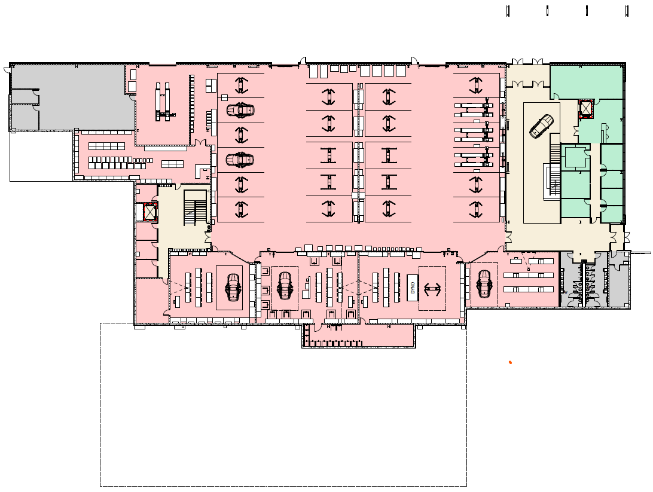
WAUBONSEE COMMUNITY COLLEGE
New TEC Facility
Lower Level Floor Plan
MAIN PUBLIC ENTRY
ADAS BAY
MECH
DEAN’S SUITE
TOOL CRIB
OF
OF
AUTOTECH LAB
OF
ENGINE
OF
STOR
TRANSMISSION
DIESEL
ELEC / HYBRID
Legend
WELDING:
CIRCULATION:
CLASSROOMS:
SERVICE:
AUTOBODY:
AUTOTECH:
DEAN’S SUITE:
EXPO:
AUTOBODY ABOVE

Slide 6
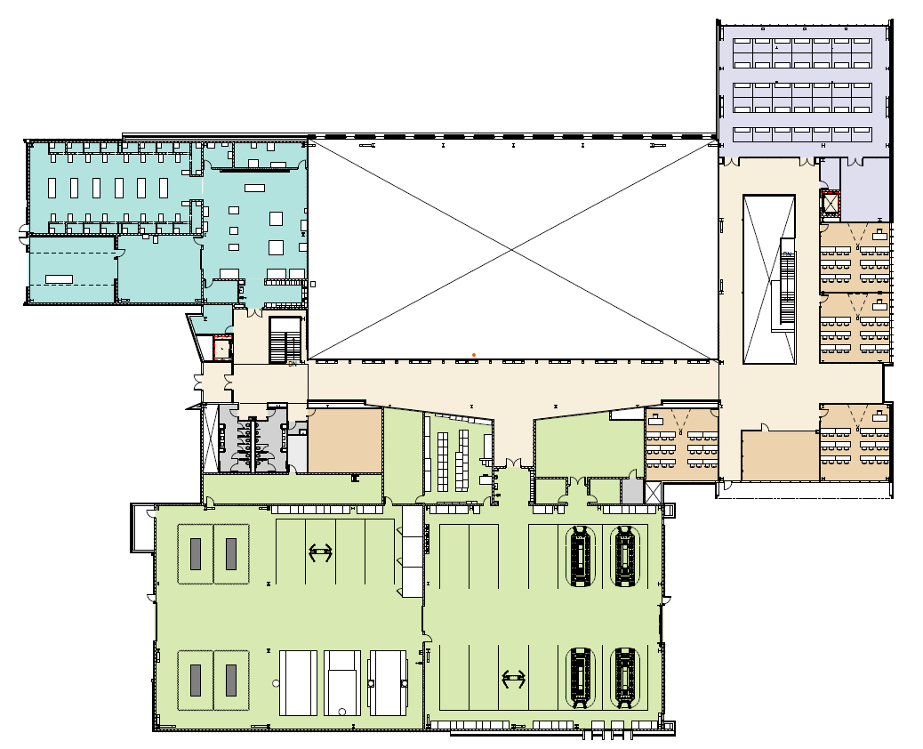
WAUBONSEE COMMUNITY COLLEGE
New TEC Facility
Upper Level Floor Plan
EXPO
WELDING
FABRICATION
OPEN TO AUTOTECH BELOW
STORAGE
EXT STOR
STOR
CLASSROOM
OF
CLASSROOM
MAIN STUDENT ENTRY
TOOL CRIB
CLASS
STOR
STOR
IDEA SPACE
CLASSROOM
STOR
OF
OF
COMPUTER LAB
Legend
WELDING:
CIRCULATION:
CLASSROOMS:
SERVICE:
AUTOBODY:
AUTOTECH:
DEAN’S SUITE:
EXPO:
AUTOBODY PAINT
AUTOBODY FRAME

Slide 7
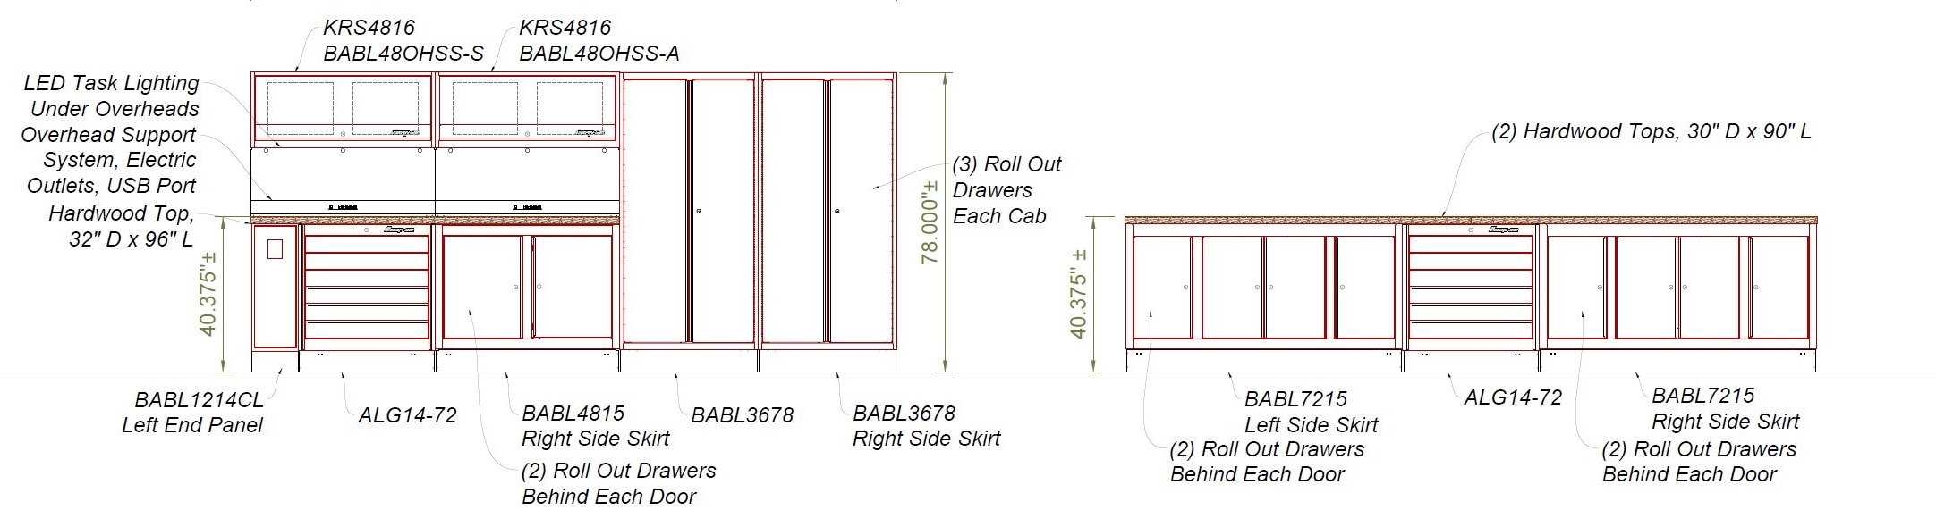
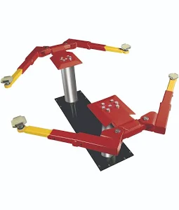
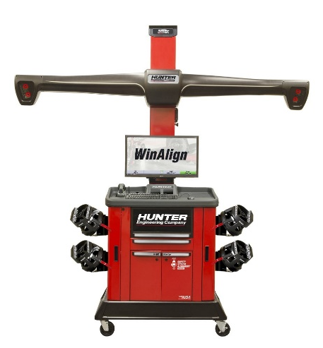
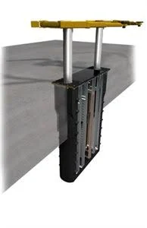
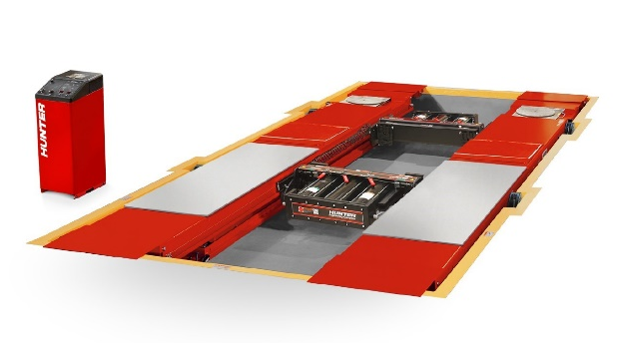
WAUBONSEE COMMUNITY COLLEGE
New TEC Facility
Equipment Coordination

Slide 8
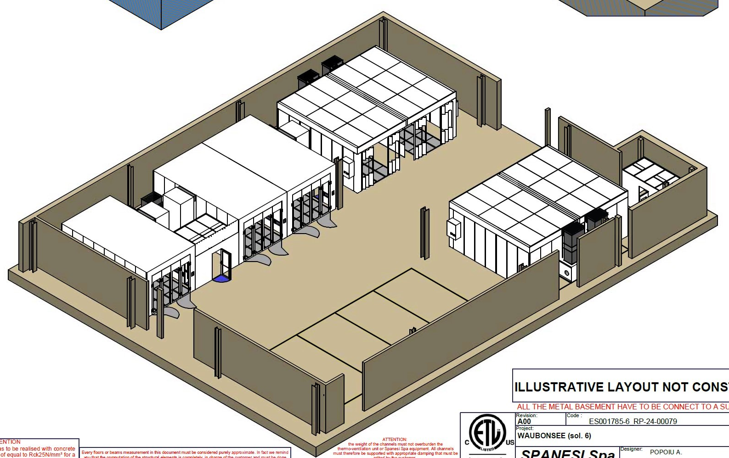
WAUBONSEE COMMUNITY COLLEGE
New TEC Facility
Equipment Coordination

Slide 9
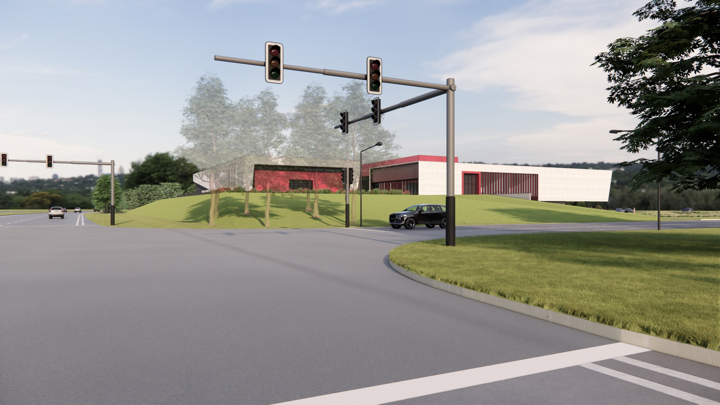
WAUBONSEE COMMUNITY COLLEGE
New TEC Facility
View from Route 47 Looking North

Slide 10
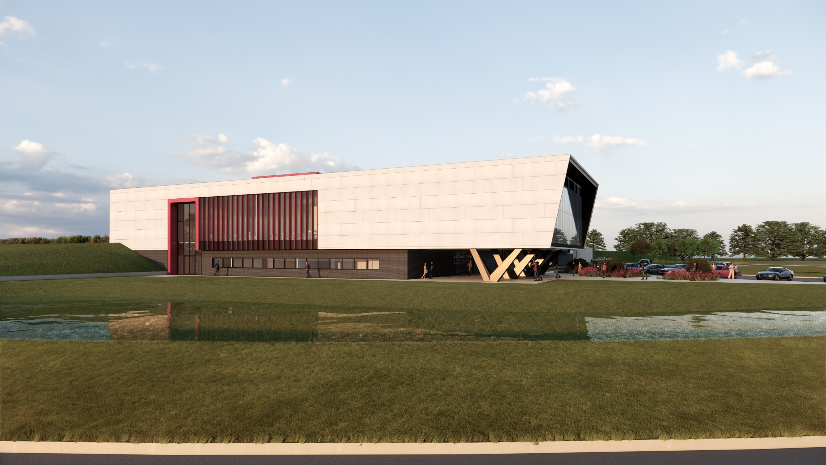
WAUBONSEE COMMUNITY COLLEGE
New TEC Facility
View from Waubonsee Drive

Slide 11
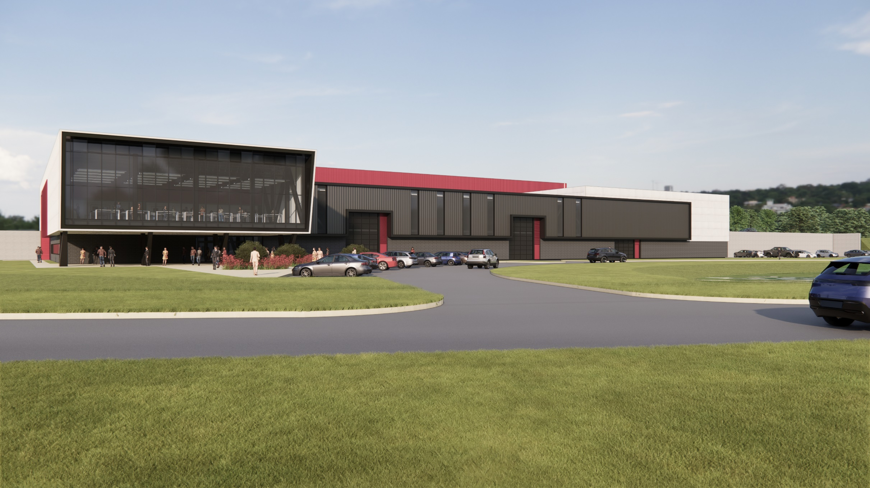
WAUBONSEE COMMUNITY COLLEGE
New TEC Facility
View from Waubonsee Drive

Slide 12
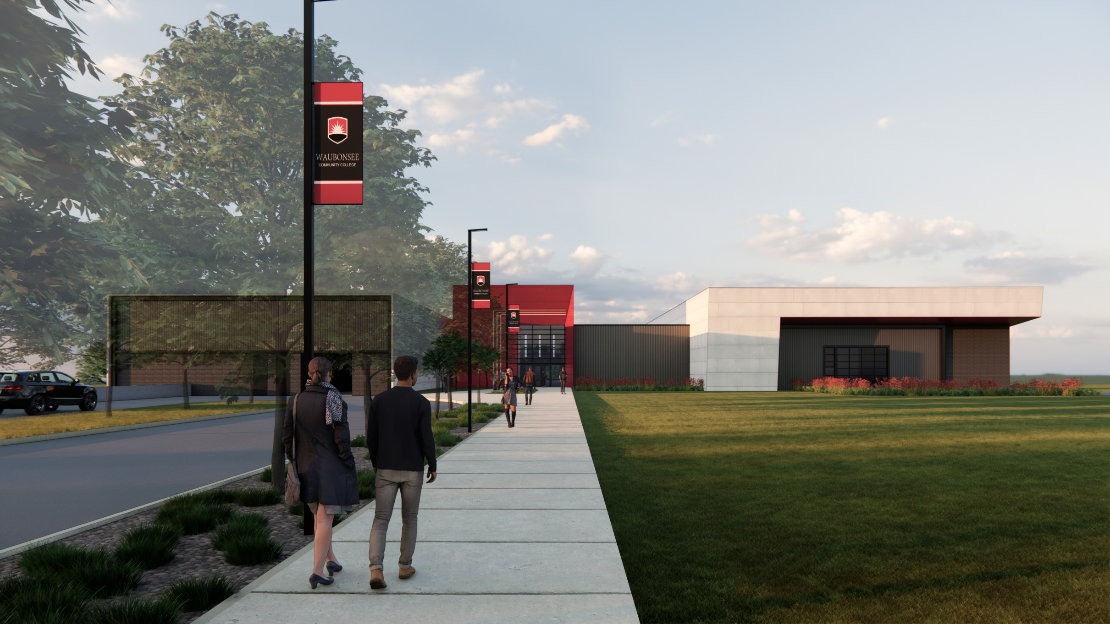
WAUBONSEE COMMUNITY COLLEGE
New TEC Facility
View of Student Entrance

Slide 13
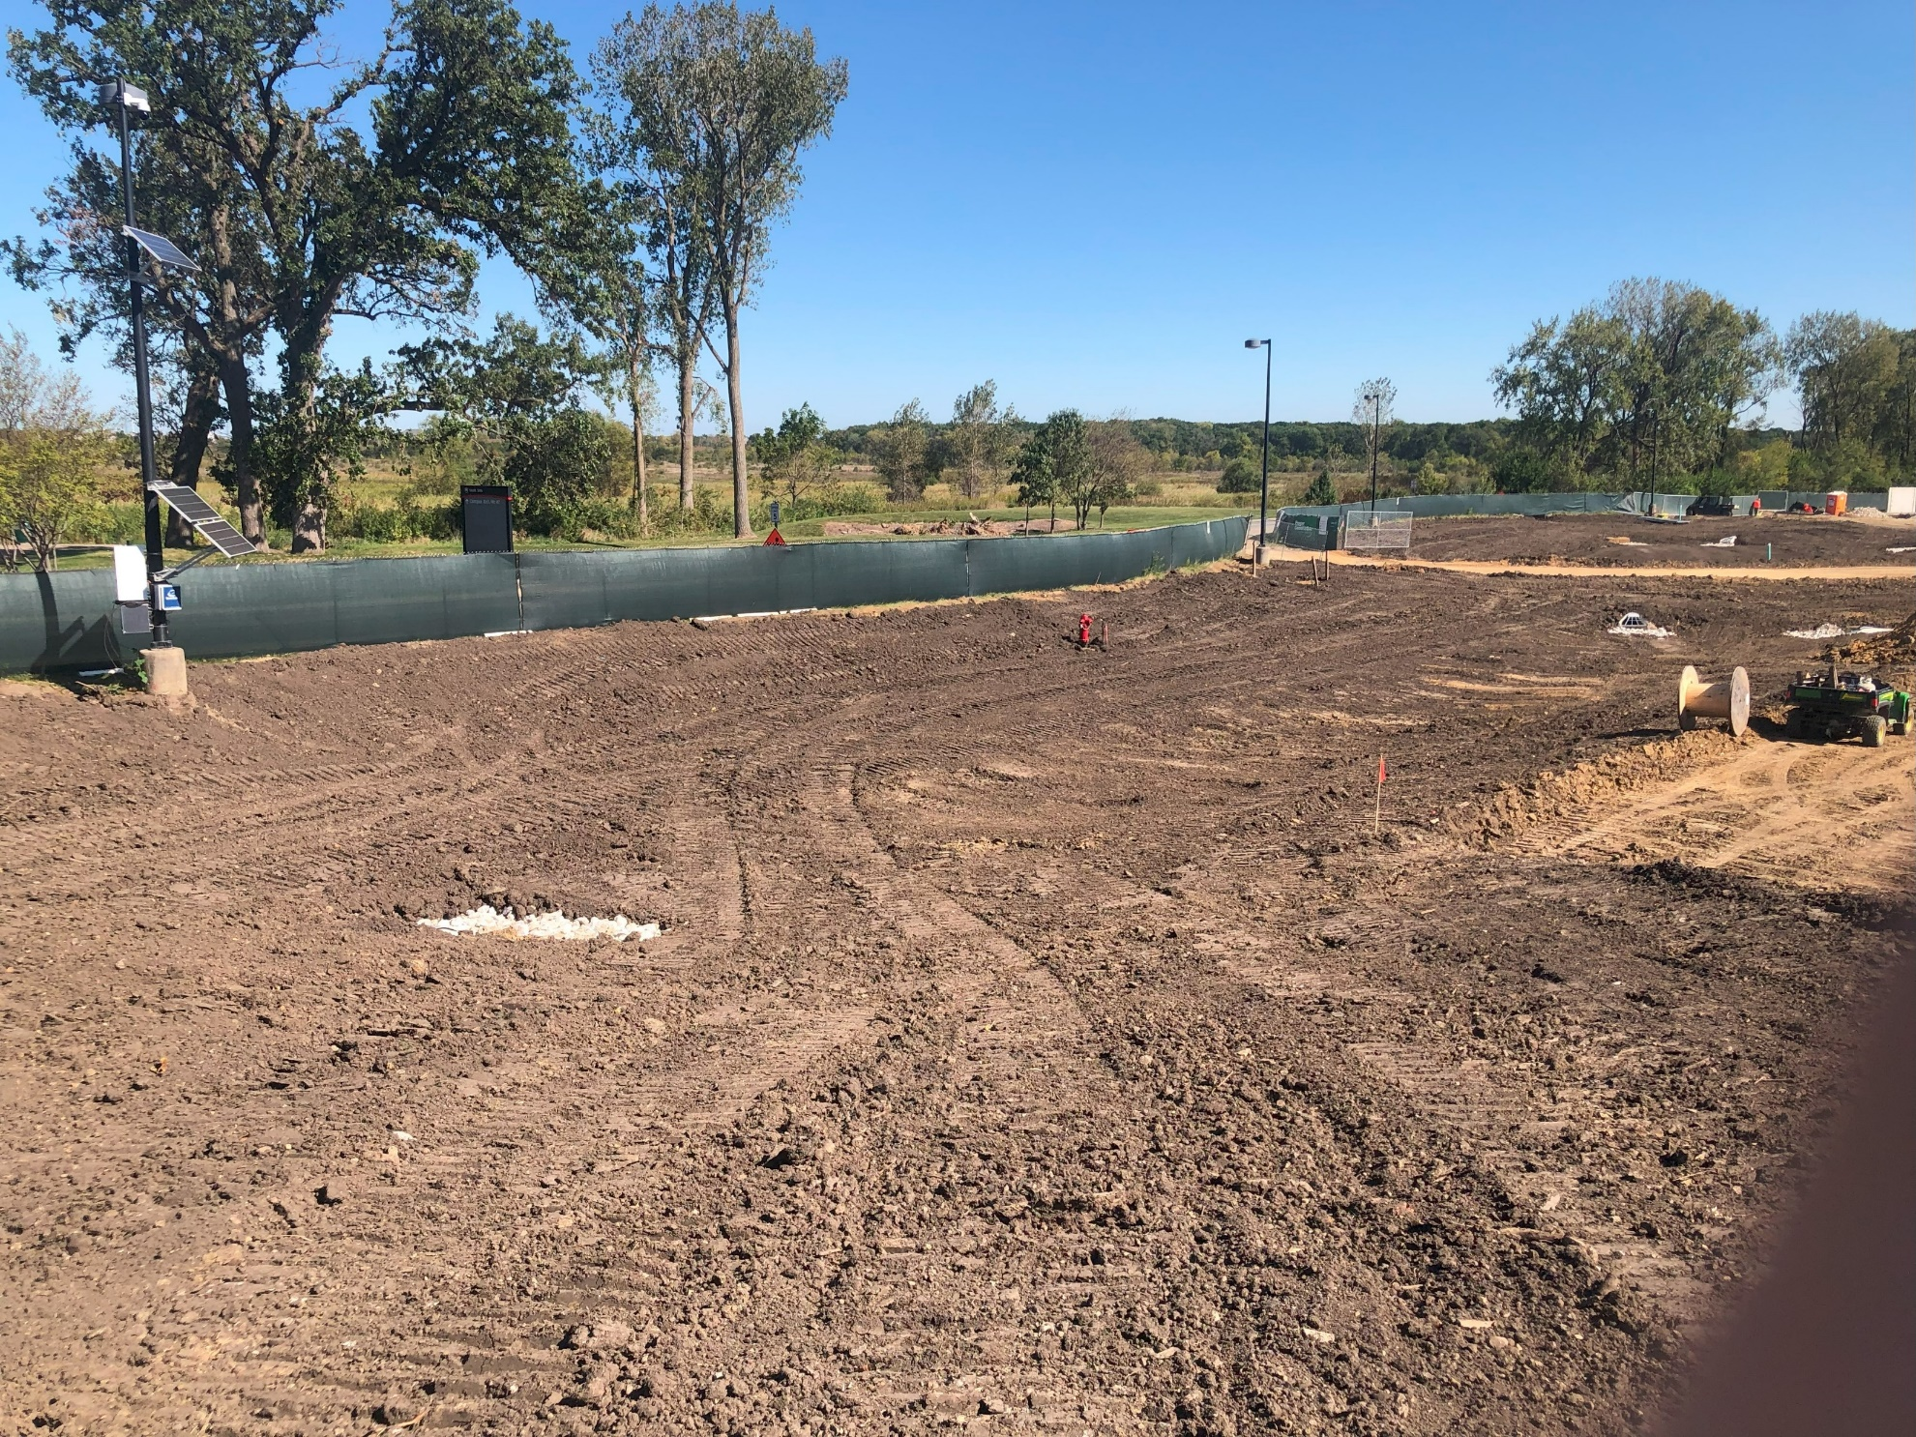
WAUBONSEE COMMUNITY COLLEGE
New TEC Facility
Earthwork

Slide 14
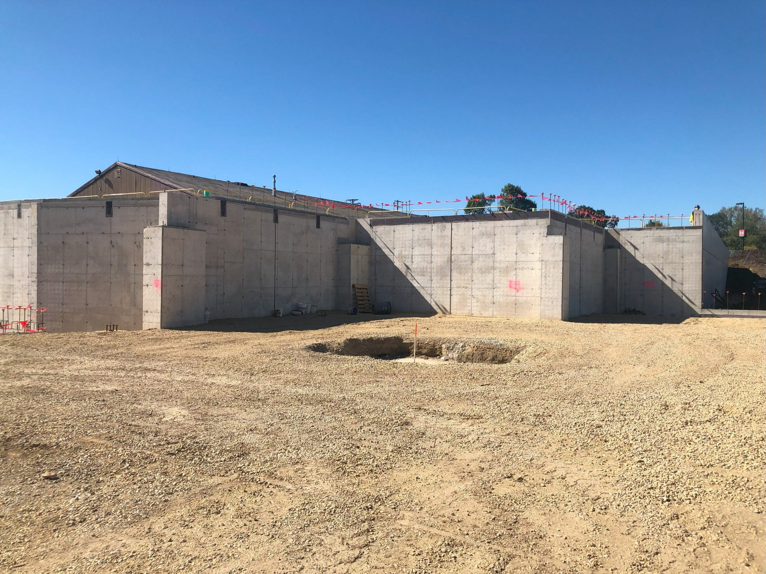
WAUBONSEE COMMUNITY COLLEGE
New TEC Facility
Concrete Work

Slide 15
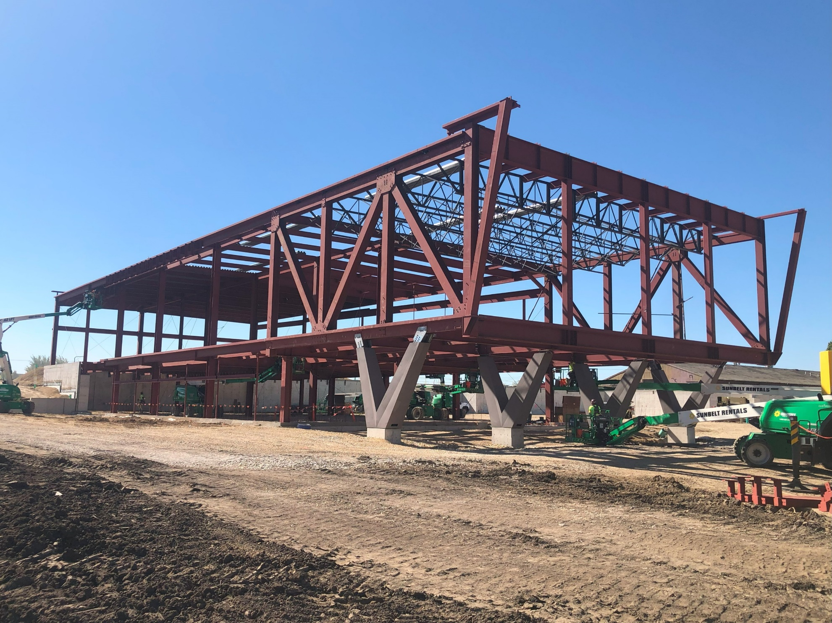
WAUBONSEE COMMUNITY COLLEGE
New TEC Facility
Steel Work

Slide 16
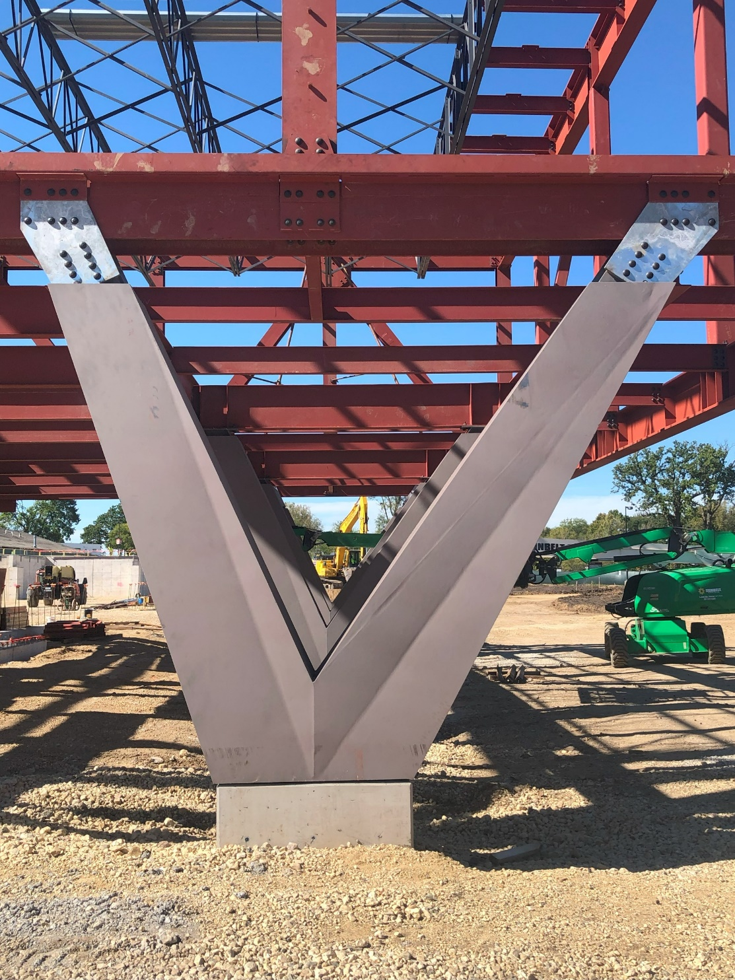
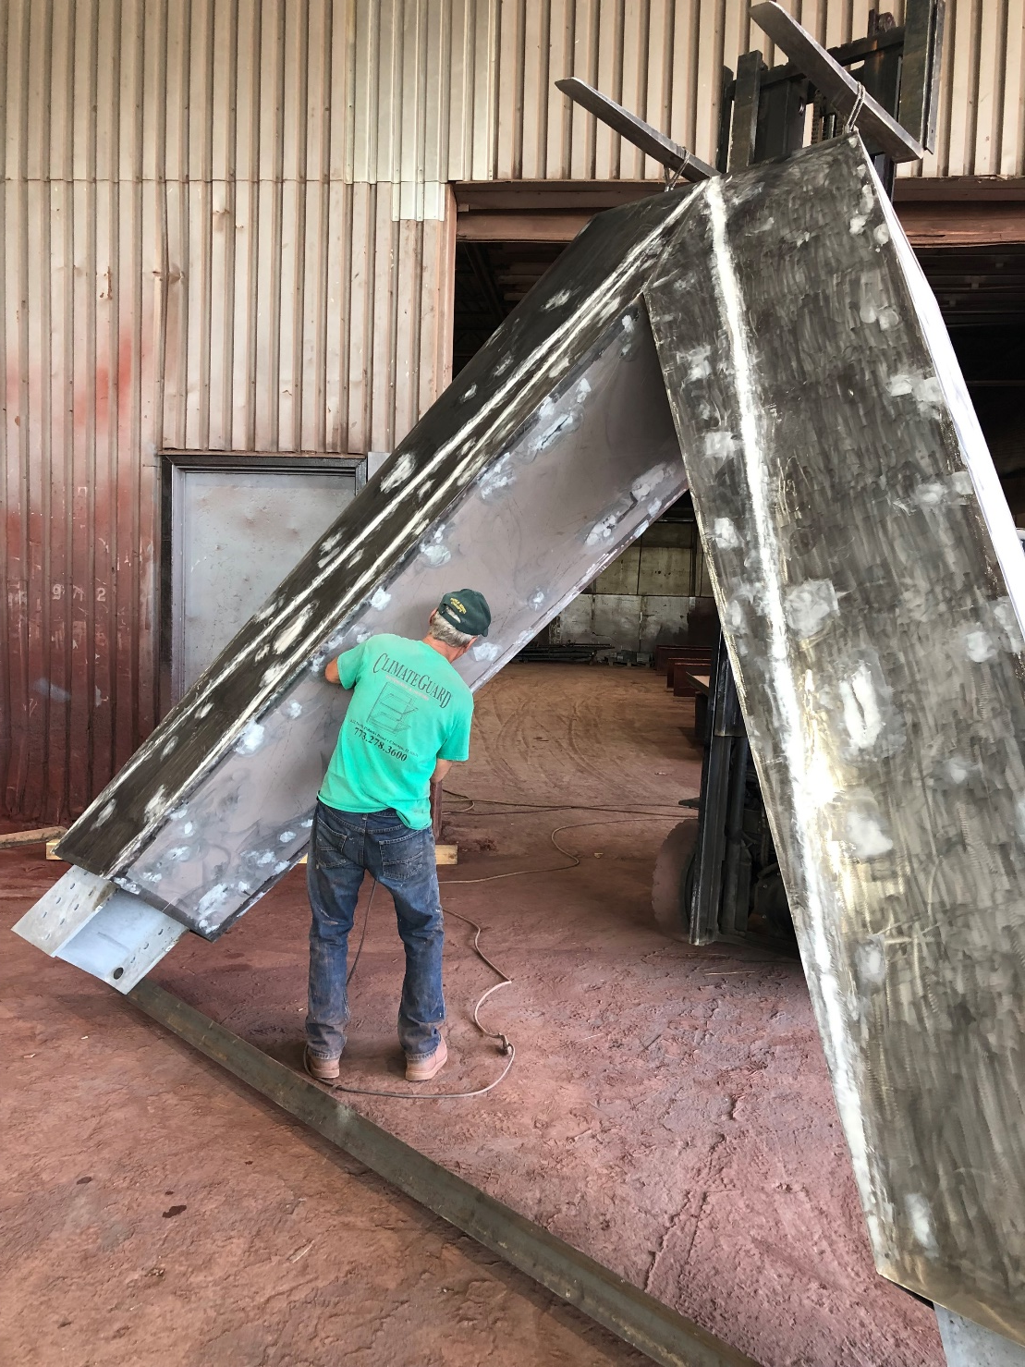
WAUBONSEE COMMUNITY COLLEGE
New TEC Facility
Steel Work

Slide 17
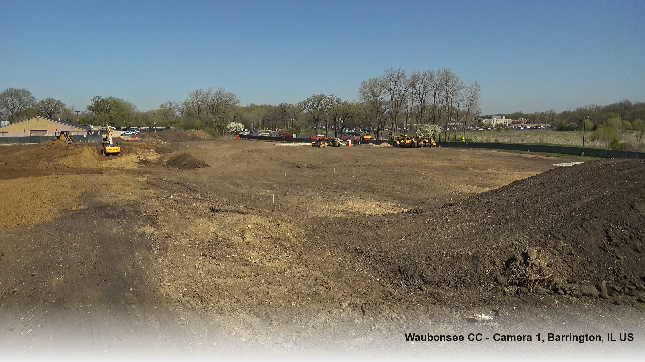
WAUBONSEE COMMUNITY COLLEGE
New TEC Facility
Time Lapse Video (April – October 2024)

